Slide 1
Computational Analysis of Religious and Ideological Linguistic Behavior
Seth Green, Megan Stiles, Katherine Harton, Samantha Garofalo

Slide 2
Problem: How to work with Value-Based Groups?
What is a Value-Based Group?
Any group motivated by a set of values
Who needs to work with Value-Based groups?
US Government
Humanitarian Groups
Business Leaders
Large-Scale Goals:
Real-time recommendations to organizations on the ground

Slide 3
UVa Center for Religion, Politics, and Conflict
1-9 Linguistic Rigidity Scale
Number of definitions not the definition itself is what matters
Venuti et al. automated model
1 2 3 4 5 6 7 8 9
Holy
Holy
Self-Sacrifice
Compassion
Wisdom
Trustworthiness

Slide 4

About Our Data
Input
Raw ideological text
Output
Number on Linguistic Rigidity Scale
Sources:
Last year’s corpus
New Groups
Web Scraping
OCR for PDFs
5

Slide 5
Technical Approach

Slide 6
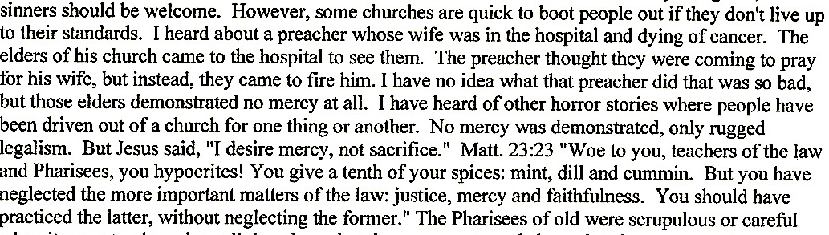
Context Vectors
Raw Text

Slide 7
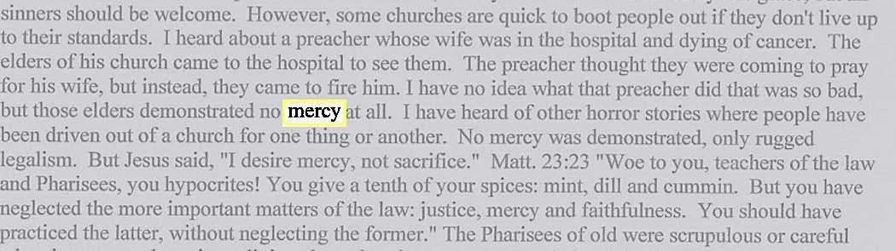
Context Vectors
Identify Keywords

Slide 8
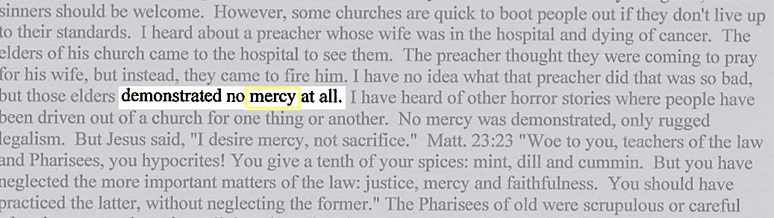
Context Vectors
Collect words in context vector

Slide 9
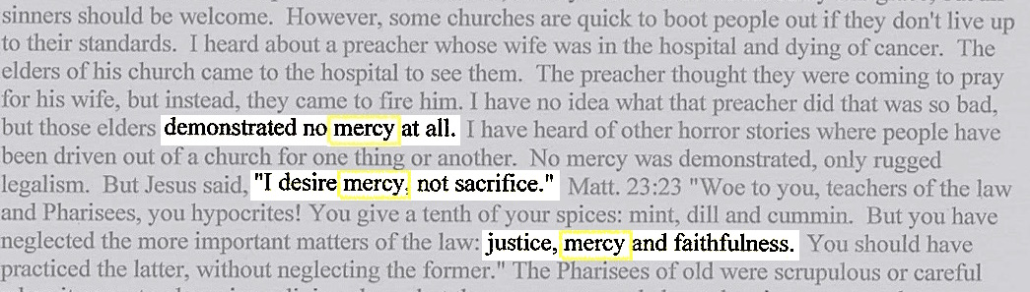
Context Vectors
Repeat for all occurrences of keyword
Singular Value Decomposition to vector of length 100
Calculate Average Semantic Density and Distributional Co-occurrence Score

Slide 10
Keyword Selection

Slide 11
TFIDF Matrix
 | freq | idf | logidf | tfidf | logtfidf
thee | 18 | 139.000000 | 4.934474 | 2502.000000 | 88.820531
prophet | 12 | 139.000000 | 4.934474 | 1668.000000 | 59.213687
me | 12 | 139.000000 | 4.934474 | 1668.000000 | 59.213687
we | 21 | 75.818182 | 4.328338 | 1592.181818 | 90.895101
uniti | 9 | 139.000000 | 4.934474 | 1251.000000 | 44.410265
fate | 8 | 139.000000 | 4.934474 | 1112.000000 | 39.475791
muhammad | 8 | 139.000000 | 4.934474 | 1112.000000 | 39.475791
decre | 8 | 139.000000 | 4.934474 | 1112.000000 | 39.475791
christ | 10 | 104.250000 | 4.646792 | 1042.500000 | 46.467919

Slide 12
Value Words
TFIDF Method w/Pronouns
TFIDF Method w/out Pronouns
Previous Method

Slide 13
Judgment Classification
Previous Method:
Judgment = (noun + “to be” verb + adj/adv)
New Method:
Judgment = pronoun + key word

Slide 14
Judgment Classification

Slide 15
Pronoun Analysis

Slide 16
Results – Group Scores
97%

Slide 17
Results – Group Scores
Compared to Previous Methods using Previous Corpus
Using Full Data Set
Model | Accuracy | Previous Work
Random Forest | 96.5 | 86.0
SVM | 97.2 | 84.0
Boosted Tree | 96.2 | N/A
Artificial Neural Net | N/A | 80.0
Average | 96.6 | 83.3
Model | Accuracy
Random Forest | 96.1
SVM | 96.3
Boosted Tree | 95.4
Average | 96.0

Slide 18

Single Document Analysis
Why Single Documents?
Identifying potential spikes or deviations from a groups baseline
Moving towards real-time, on-the-ground analysis
# of Documents
342
Results
~77% accuracy
3
4
5

Slide 19
Word Embeddings
What are Word Embeddings?
Vocabulary mapped to vectors
Westboro Baptist Church
John Piper

Slide 20
Questions?

Slide 21
Acknowledgment
The CL team would like to thank Professor Peter Ochs, Jonathan Teubner, Essam Fahim, and Syed Moulvi of the University of Virginia’s Religious Studies department for their expertise and critical insights. The work for this paper is partially supported by a grant from the U.S. Army Research Laboratory.

Slide 22
References
Consultation with researchers at the University of Virginia Center for Religion, Politics, and Conflict (RPC). 1540 Jefferson Park Avenue, University of Virginia, Charlottesville, VA 22904-4126.
Venuti, Nicholas, Sachtjen, Brian, McIntyre, Hope, et al. “Predicting the Tolerance Level of Religious Discourse Through Computational Linguistics,” presented at the 2016 IEEE Systems and Information Engineering Design Conference (SIEDS ‘16), Charlottesville, VA, 2016.
Wade-Benzoni, Kimberly A., Hoffman, Andrew J., Thompson, Leigh L., et al. 2002. "Barriers to resolution in ideologically based negotiations: The role of values and institutions." Academy of Management Review 27, pp. 41-57.
Lederach, John Paul and Appleby, Scott R. “Strategic Peacebuilding: An Overview,” in Daniel Philpott and Gerard Powers, Strategies of Peace (Oxford: Oxford University Press, 2010), pp. 19-44.
“Algorithmia.” 2016. http://blog.algorithmia.com/introduction-natural-language-processing-nlp/. Accessed: March 30, 2017.
“Expert System: Natural language processing and text mining.” 2016. http://www.expertsystem.com/natural-language-processing-and-text-mining/. Accessed: March 30, 2017
Gupta, Vishal. and Lehal, Gurpreet S., 2009. “A survey of text mining techniques and applications.” Journal of emerging technologies in web intelligence, 1(1), pp.60-76.
Gabrilovich, Evgeniy and Markovitch, Shaul. January 2007. “Computing semantic relatedness using wikipedia-based explicit semantic analysis.” (In IJcAI Vol. 7), pp. 1606-1611
James, Gareth, Witten, Daniela, Hastie, Trevor, et al. 2013. Introduction to Statistical Learning, pp 303-372.
Palomino-Garibay, Alonso, Camacho-González, Adolfo T., Fierro-Villaneda, Ricardo A., et al. 2015. “A random forest approach for authorship profiling.” Cappellato et al. [8].
Treeratpituk, Pucktada and Giles, C. Lee. June 2009. “Disambiguating authors in academic publications using random forests.” In Proceedings of the 9th ACM/IEEE-CS joint conference on Digital libraries, pp. 39-48.
Joachims, Thorsten, 1998. “Text categorization with support vector machines: Learning with many relevant features.” Machine learning: ECML-98, pp.137-142.
Özgür, Arzucan, Levent Özgür, and Tunga Güngör. "Text categorization with class-based and corpus-based keyword selection." International Symposium on Computer and Information Sciences. Springer Berlin Heidelberg, 2005.
Richardson, Leonard. Beautiful soup documentation, [Online] Available: https://www.crummy.com/software/BeautifulSoup/bs4/doc/.
Bird, Steven, Edward Loper and Ewan Klein (2009), Natural Language Processing with Python. O’Reilly Media Inc. Available: http://nltk.org/book
Pennington, Jeffrey, Richard Socher, Christopher D. Manning. "GloVe: Global Vectors for Word Representation." Proceedings of the 2014 Conference on Empirical Methods in Natural Language Processing. 2014.
Csardi, G. and Nepusz, T. Package ‘igraph’. [Online]. Available: http://igraph.org/python/
Íñigo-Mora, Isabel. "On the use of the personal pronoun we in communities." Journal of Language and Politics. Volume 3, Issue 1, 2004, pages: 27–52.
Maitland, Karen and John Wilson. "Pronominal selection and ideological conflict." Journal of Pragmatics. Volume 11, Issue 4, August 1987, Pages 495-512.
Karatzoglou, Alexandros, Alex Smola, and Kurt Hornik, Package ‘kernlab’.[Online] Available: https://cran.r-project.org/web/packages/kernlab/kernlab.pdf
Liaw, Andy and Matthew Wiener, R Package ‘randomForest’. [Online] Available: https://cran.r-project.org/web/packages/randomForest/randomForest.pdf
Chen, Tianqi, Tong He, Michael Benesty, Vadim Khotilovich, and Yuan Tang, Package ‘xgboost’ [Online] Available: https://CRAN.R-project.org/package=xgboost

